Slide 1
Test Types
Prezi: Online Presentation tool
Nataliia Sheludiakova
January 2016

Slide 2


Object for testing:
Prezi: Online Presentation tool

Slide 3

Agenda
- Smoke testing
- Functional testing
- Positive testing
- Negative testing
- Integration testing
- Non-functional testing: UI
- Performance testing
- Load testing
- Stress testing
- Localization testing

Slide 4
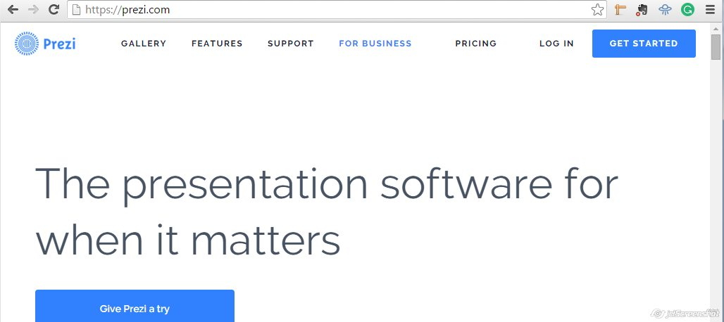

Smoke testing
Requirement: As a Tester, I need to be confident in ability for further testing.
Smoke Testing Procedure:
1. Open URL: https://prezi.com/
Expected result:
The Page is opened.

Slide 5

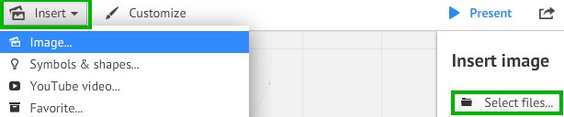
Functional testing
Requirement: As a User I need to upload Images in the JPEG format from My device, so then I can improve the presentation.
Functional Testing Procedure:
1. Open https://prezi.com/login/
2. Type valid values for registered user into ‘Email’, ‘Password’ fields
3. Click on ‘Log in’ button
4. Press ‘New Prezi’ button
5. Press on any template
6. Press on ‘Insert’ button - > Select ‘Image’ item - > Press ‘Select files…’ button - > Choose the image - > Press ‘Open’ button
Expected result:
Chosen image is uploaded.

Slide 6

Positive testing
Requirement: As a registered User, I want to have possibility to enter the system.
Positive Testing Procedure:
1. Open URL: https://prezi.com/login/
2. Type valid values into ‘Email’, ‘Password’ fields
3. Press ’Log in’ button
Expected result:
Registered User logged in successfully.

Slide 7

Negative testing
Requirement:
As a User I should enter at least 8 characters into ‘Password’ field.
Negative Testing Procedure:
1. Open URL: https://prezi.com/signup/public/
2. Type valid values into First name’, ‘Last name’, ‘Email’ fields
3. Put 5 characters into ‘Password’ field
4. Choose the value from ‘So what do you do’ and ‘Select one…’ dropdown lists
5. Press ’Create your free Public account’ button
Expected result:
Error message ‘Please enter at least 8 characters’
appears below corresponding field.
‘Password’ field is highlighted with red color.
‘x’ sign appears on the right side of ‘Password’ field.
Entered characters transformed in bullets at once after entering.

Slide 8
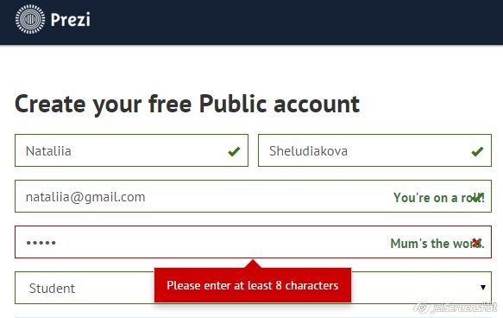
Result:

Slide 9

Integration testing
Requirement: After creating free Public account in Prezi the User can log in the system with his new credentials.
Integration Testing Procedure:
1. Open URL: https://prezi.com/signup/public/
2. Type valid values into ‘First name’, ‘Last name’, ‘Email’, ‘Password’ fields
3. Choose the value from ‘So what do you do’ and ‘Select one…’ dropdown lists
4. Push ’Create your free Public account’ button
Expected result:
New Public account is created.
Integration Testing Procedure:
5. Click ‘Log in’ link
6. Type valid values into ‘Email’, ‘Password’ fields
7. Press ’Log in’ button
Expected result:
Registered User logged in successfully.

Slide 10
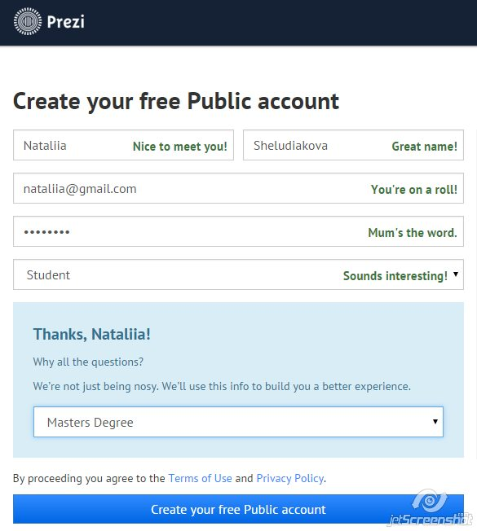
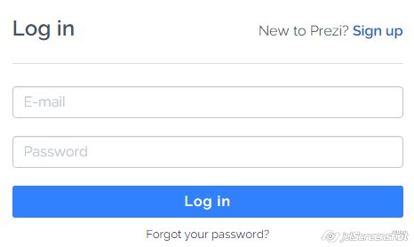
Result:

Slide 11
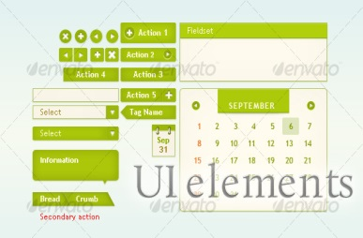
Non-functional testing: UI
Requirements: As a registered User I want to have my menu with ‘First’ and ‘Last’ names in the right corner of the header.
UI Testing Procedure:
1. Open URL: https://prezi.com/login/
2. Type valid values for registered user into ‘Email’, ‘Password’ fields
3. Press ’Log in’ button
4. Observe the right corner of the header
Expected result:
The Menu is located in the top right corner of the Prezi main page.
The ‘Menu’ label consists of User’s First and Last names and triangle sign at the end. The Menu is always enable.

Slide 12


Performance testing
Requirement: As a User I want to have respond from the system in less than 10 sec after pressing ‘New Prezi’ button on the ‘Your Prezis’ page.
Performance Testing Procedure:
1. Open URL: https://prezi.com/login/
2. Type valid values for registered user into ‘Email’, ‘Password’ fields
3. Press ’Log in’ button
4. On the ‘Your Prezis’ page press button ‘New Prezi’
5. Measure spent time in seconds
Expected result:
The system responds in less than 10 sec.
Loading…
Less than 10 sec

Slide 13




Result:
Actual result for different browsers:
Loading…
40 sec
39 sec
21 sec
15 sec

Slide 14

Load testing
Requirement: As a System I need to support the work of 500 users simultaneously.
Load Testing Procedure:
1. Open https://prezi.com/login/
2. Type valid values for registered user into ‘Email’, ‘Password’ fields
3. Click on ‘Log in’ button
4. Press ‘New Prezi’ button
5. Repeat steps 1-4 500 times (use automation tool)
Expected result:
500 users can work simultaneously.

Slide 15

Stress testing
Requirement: As a System I need to support the work of 500 users simultaneously.
Stress Testing Procedure:
1. Open https://prezi.com/login/
2. Type valid values for registered user into ‘Email’, ‘Password’ fields
3. Click on ‘Log in’ button
4. Press ‘New Prezi’ button
5. Repeat steps 1-4 600 times (use automation tool)
Expected result:
500 users can work simultaneously.
Other 100 users will get Error message:
‘The service is temporary unavailable.
Please try again later.’

Slide 16

Localization testing
Requirement: As a User I want to change the language on the login page, so all textual information should be translated into selected language.
Localization Testing Procedure:
1. Open https://prezi.com/login/
2. Type valid values for registered user into ‘Email’, ‘Password’ fields
3. Click on ‘Log in’ button
4. Observe Login page – English Language (by default)
5. Choose German Language on the footer
6. Check all textual information on the page whether it is translated into German
Expected result:
All textual information on the page
is translated into selected language.

Slide 17
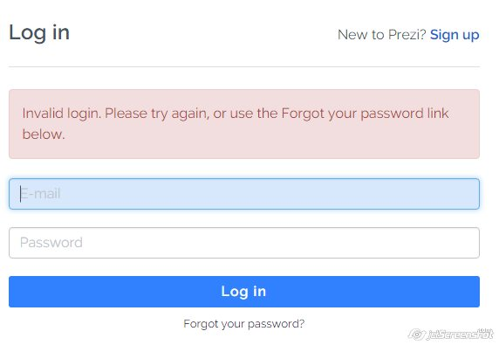
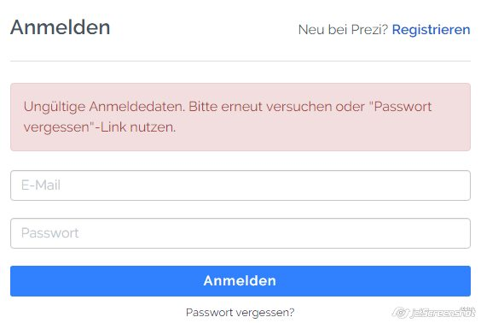
Result (compare two pages):

Slide 18
Thank you
US OFFICES
Austin, TX
Fort Myers, FL
Boston, MA
Newport Beach, CA
Salt Lake City, UT
EUROPE OFFICES
United Kingdom
Germany
The Netherlands
Ukraine
Bulgaria
EMAIL
info@softserveinc.com
WEBSITE:
www.softserveinc.com
USA TELEPHONE
Toll-Free: 866.687.3588
Office: 239.690.3111
UK TELEPHONE
Tel: 0207.544.8414
GERMAN TELEPHONE
Tel: 0692.602.5857

